Slide 1
Troubleshooting and security of Network

Slide 2
Establish A Baseline
The single most important tool you can use to troubleshoot your network is to have established and documented a network baseline.
Due to the time consuming nature of establishing a network baseline through testing, analysis and documentation it is also the single most neglected too
What is a Baseline?
A baseline is a process for studying the network at regular intervals to ensure that the network is working as designed and documentation of the findings.
It is more than a single report detailing the health of the network at a certain point in time. Establishing a baseline defines the parameters under which it operates, its limits and behavior under specific conditions.

Slide 3
Why Establish a Baseline?
Identify Normal vs. Abnormal Function
Plan For Potential Problems and Future Growth
Procedure For Establishing a Baseline
Develop and maintain a Site Network Map
Device physical location , Easily identify the users and applications affected by a problem with each device

Slide 4
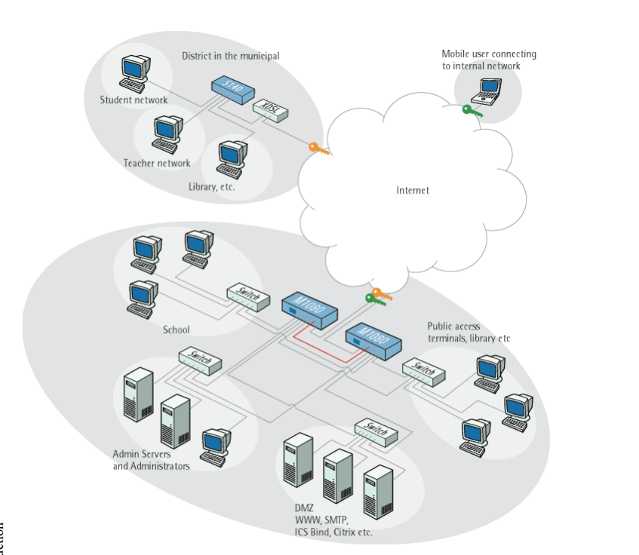

Slide 5
Procedure For Establishing a Baseline
Include Details of Logical Connections
Logical and physical connections
Compile a Hardware, Software, and Configuration Inventory (Network Notebook)
All passwords - Store passwords in a safe place
Device inventory - The inventory allows you to see the device type, IP address, ports, MAC addresses, and attached devices at a glance
MAC address-to-port number list - If your hubs or switches do not have an OS that enables management, you should keep a list of the MAC addresses that correlate to the individual ports. Generate and keep a paper copy of this list
Logbook - Document your interactions with network devices and software systems (routers, remote access devices, security servers, and application servers)
Change control - Maintain a change control system for all critical systems. Permanently store change control records.
Contact details - Store, online and on paper, the details of all support contracts, support numbers, engineer details, and telephone and fax numbers.

Slide 6
Collect Statistical Data for Network
Total Bandwidth Utilization For LAN & WAN
Outbound Bandwidth Utilization
Inbound Bandwidth Utilization
Protocols and Ports Used
Time of Day for Highest Utilization , Network Segment
Analyze Data and Establish Thresholds
Physical health analysis Review and evaluate your networks physical topology and verify that it conforms to current IEEE standards
Broadcast Analysis Unicast, Multicast and broadcast
Network capacity overload analysis
Fix Immediate Problems Identified

Slide 7
Network Problems Analysis
Performance Problems
Sources of Network Slowness : Bad routing, cabling , Misconfigured DNS , Malware etc
Duplex and Speed Setting Mismatches
IP Address Conflicts
Network Congestion
Hardware Failure

Slide 8
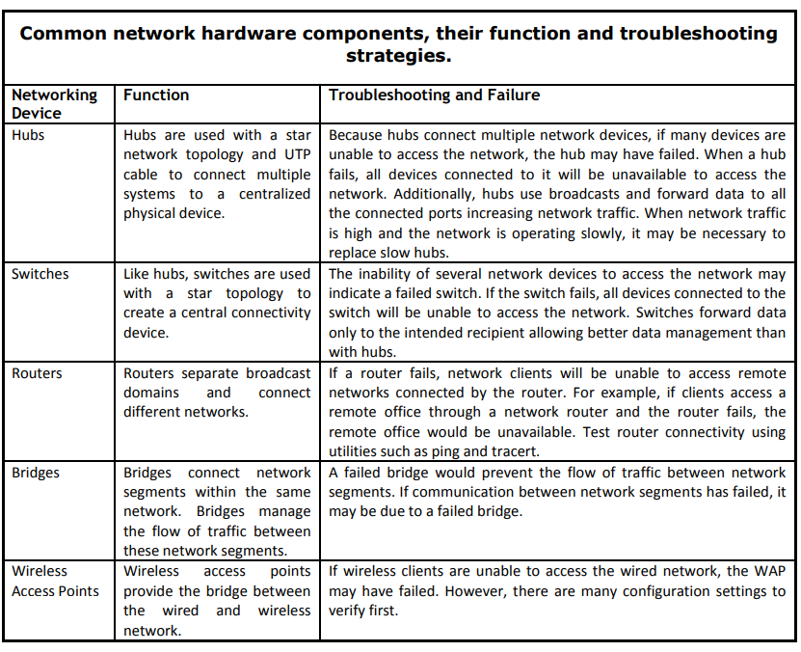

Slide 9
Network Loops
Routing Loops
Switching/Bridging Loops
Spyware, Worms and other Malware
Misconfiguration : DNS server , Speed mismatch
Increased Number of Connections (Network Growth)
Excessive Protocols Running on the Network
Poor Typology Design

Slide 10
Connectivity Problems
Intermittent Connectivity
Broad cast stroms

Slide 11
Hardware Tools
Cable Testers
Crimpers
Butt Set : Voice lines and check the noise
Multi meter
Toner and probe
Punch-Down Tool
Protocol Analyzers
Loopback Plug : To check physical port
Time Domain Reflectometer (TDR) /OTDR :Signal quality,Estimating cable lengths,Splice locations,Cable impedance information, Signal loss
Video Link
https://youtu.be/LeVtgGacGys?si=_1Zig1n1Zg0UzTdN

Slide 12
Software Tool
PING
TraceRT
Pathping
Netstat
NSLOOKUP
Network Monitoring Tools
NagiOS
Packet analyzer

Slide 13
Internal Security threat
Collaborator are authorized users who work with a third party to intentionally harm the organization
Lone wolf operate entirely independently and act without external manipulation or influence
Careless insider threats may be pawns or goofs
Pawn are authorized users who have been manipulated into unintentionally acting maliciously, often through social engineering techniques such as spear phishing
Goof deliberately take potentially harmful actions but harbor no malicious intent
A mole is an outsider but one who has gained insider access to the organization’s systems

Slide 14
How to improve your network’s internal security
Restrict user access controls
Employee security best practices
Data Encryption
IDPS technology helps detect and prevent cyberattacks and unauthorized activities
Network segmentation

